Slide 1
RBesT vs Bayesmeta in MAP computation
Comparison of two main frameworks to obatin MAP priors in Bayesian borrowing for clinical trials

Slide 2
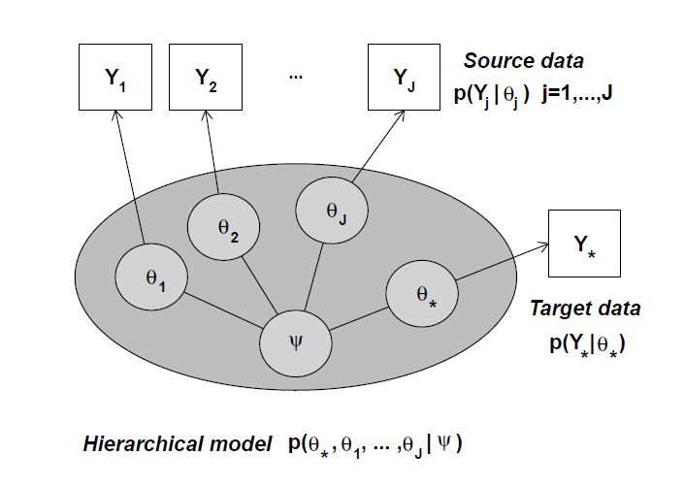
Meta-anaylisis
Likelihood
Latent parameter
Hyperparameters
Meta-analytic hierarchical model.
MAC :
p(θ₍∗₎, θ₁, ..., θⱼ | Y₍∗₎, Y₁, ..., Yⱼ).
MAP:
pMAP(θ₍∗₎) = p(θ₍∗₎ | Y₁, ..., Yⱼ).
When the MAP is updated with the new study data:
p(θ₍∗₎ | Y₍∗₎) ∝ p(Y₍∗₎ | θ₍∗₎) · pMAP(θ₍∗₎).
It is equivalent to the MAC.
MAP
MAC: when we have data of all studies
Weber. 2021

Slide 3
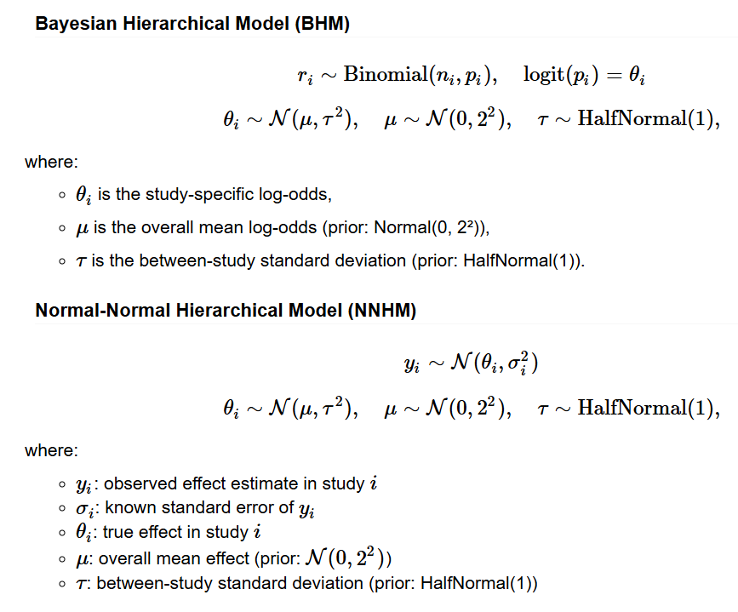
Meta-anaylisis
Likelihood Latent parameter Hyperparameters
Binary endpoint:
Canonical log-odds link (one arm).
Log-OR (two arms: contrast).
Normal endpoint:
Canonical identity link (one arm).
Mean difference (two arms: contrast).

Slide 4
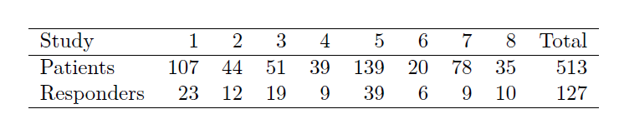
Meta-anaylisis
Binary endpoint:
Control arm borrow.
Historical data of placebo response rates used in the example ankylosing spondylitis study. The data set is available in the AS data frame as part of the RBesT package.
Weber. 2021

Slide 5
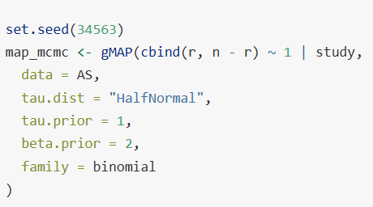
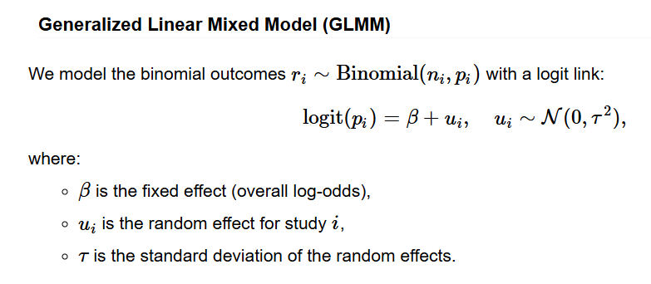
RBesT
Model.
Likelihood Latent parameter Hyperparameters

Slide 6
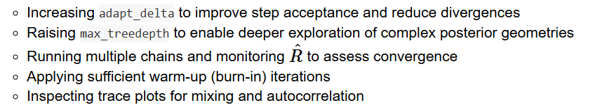
RBesT
MCMC simulation: Stan.

Slide 7
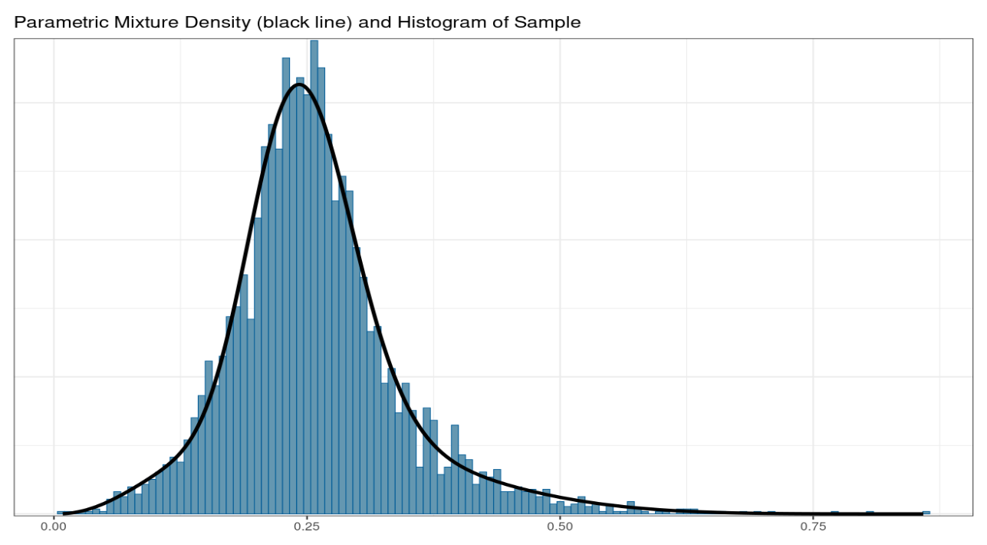
RBesT
Automixfit: gaussian, beta, gamma
Expectation-maximization (EM).
Mixture components: up to 4 elements using the Akaike information criterion (AIC), with penalty parameter = 6.
Parametric distirbution.
Weber. 2021

Slide 8
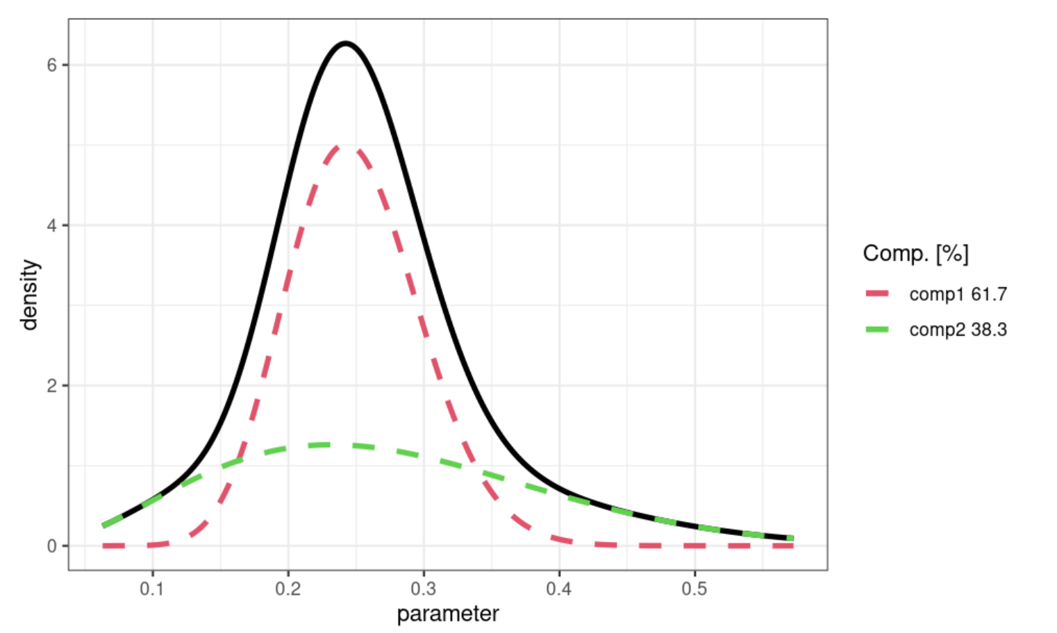
RBesT
Mixture distribution components.

Slide 9
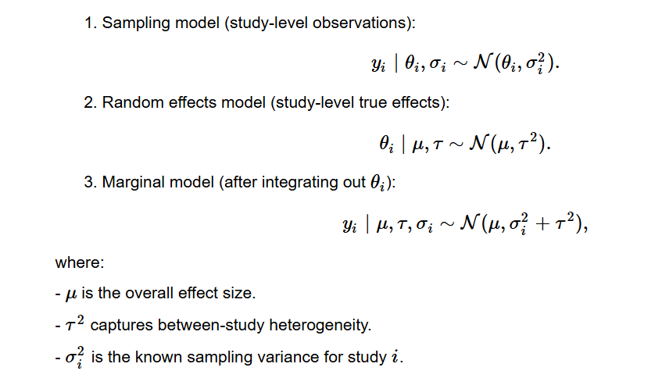
Bayesmeta
Normal-Normal hierarchical model (always)
Likelihood Latent parameter Hyperparameters Collapsed model
+ σᵢ
Collapsed model.
Röver. 2020

Slide 10
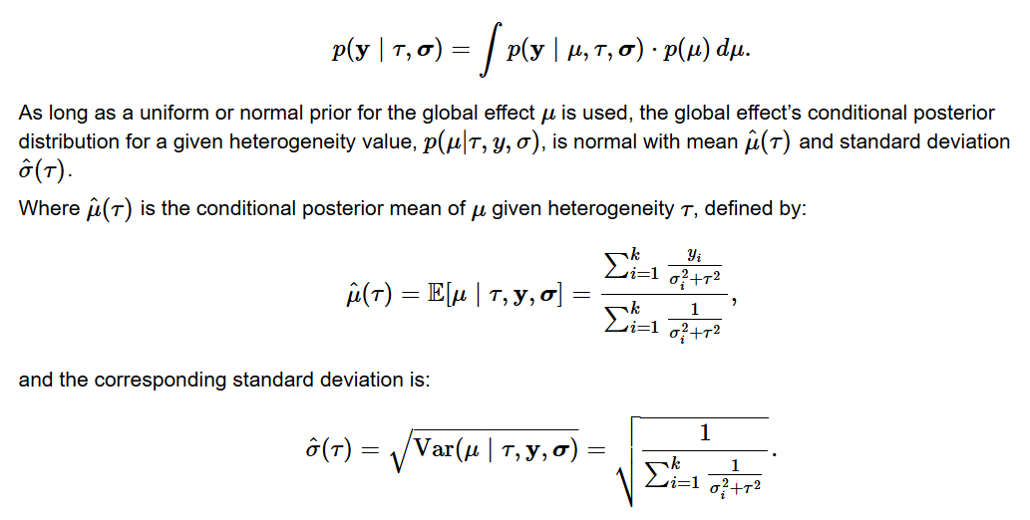
Bayesmeta
Normal-Normal hierarchical model (always)
Marginalized Likelihood.
Röver. 2020

Slide 11
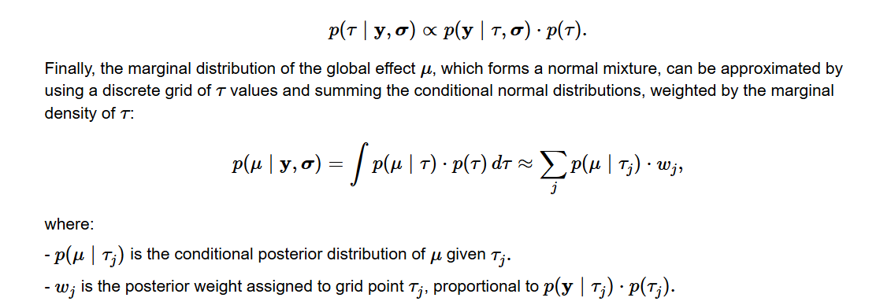
Bayesmeta
Normal-Normal hierarchical model (always)
Numerical integration (DIRECT algorithm).
Röver. 2020

Slide 12
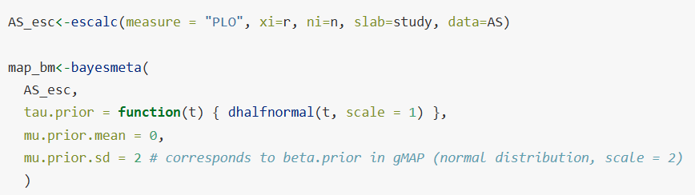



Bayesmeta
Normal-Normal hierarchical model (always)
Adapting the binary likelihood: escalc
Global scale: uisd

Slide 13

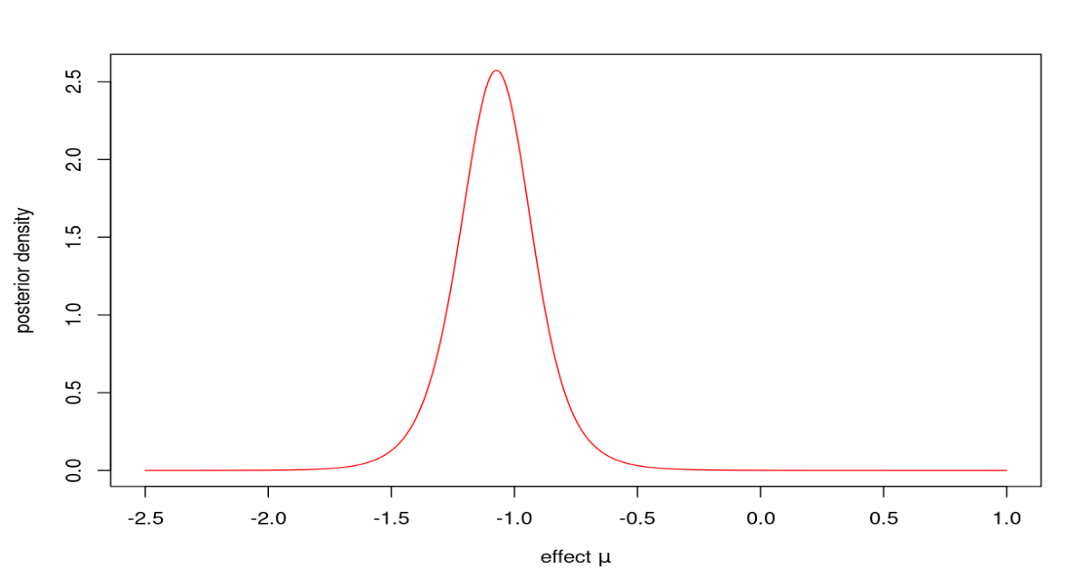
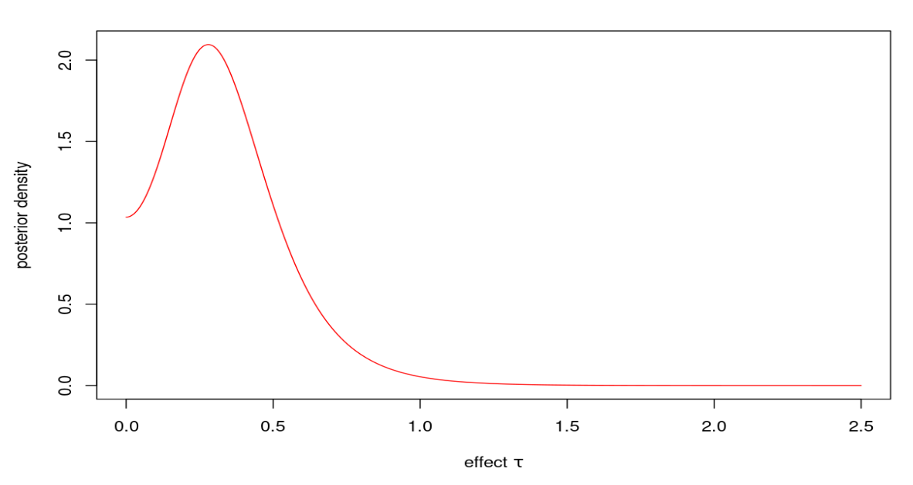
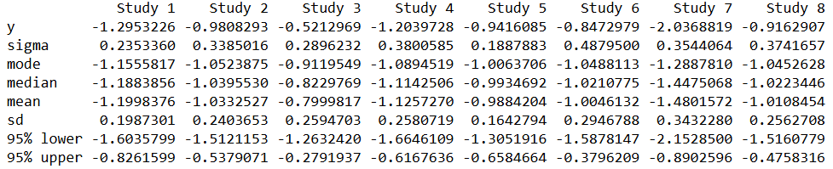
Bayesmeta
Posterior distribution:
$dposterior, $pposteiror, $qposterior, $rposterior
Posterior shrinkage:
$theta
Posterior predictive: (predict = TRUE)
Posterior distributions
(in logit scale for binary endpoint).

Slide 14
Bayesmeta
Posterior distribution:
$dposterior, $pposteiror, $qposterior, $rposterior
Posterior shrinkage:
$theta
Posterior predictive: (predict = TRUE)
Posterior distributions
(in logit scale for binary endpoint).

Slide 15

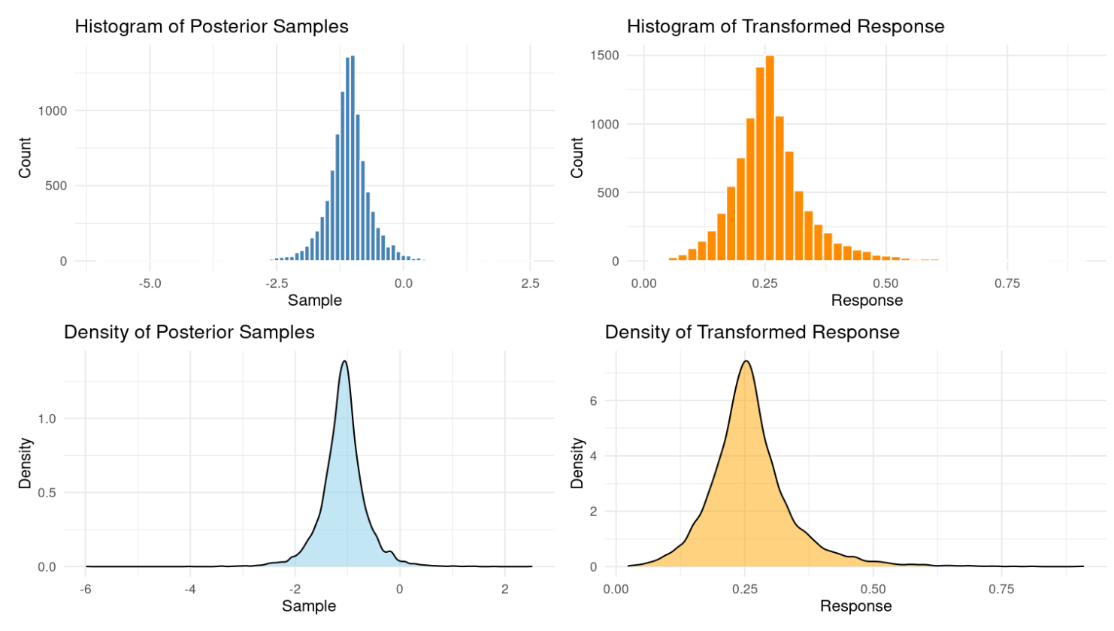
Bayesmeta
Density distribution:
$rposterior
Posterior predictive in response scale for binary endpoint.

Slide 16
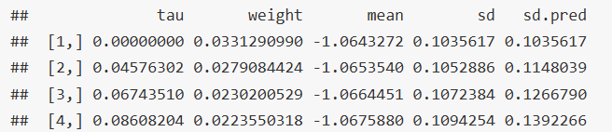
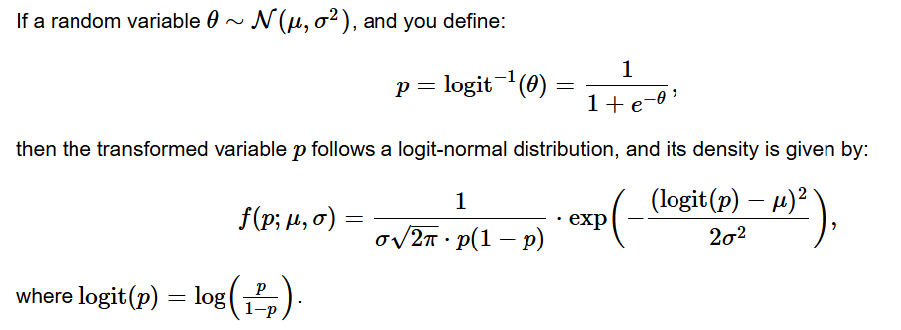
Bayesmeta
Density distribution:
$support
Posterior predictive in response scale for binary endpoint: logit-normal (linearity of pushforwards).
Frederic and Lad 2003; Betancourt 2023

Slide 17
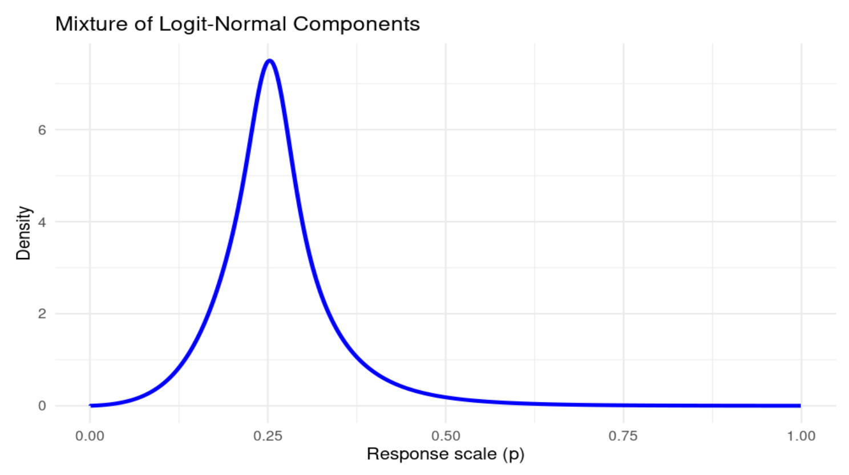
Bayesmeta
Posterior predictive: logit-normal (pushforwards).

Slide 18

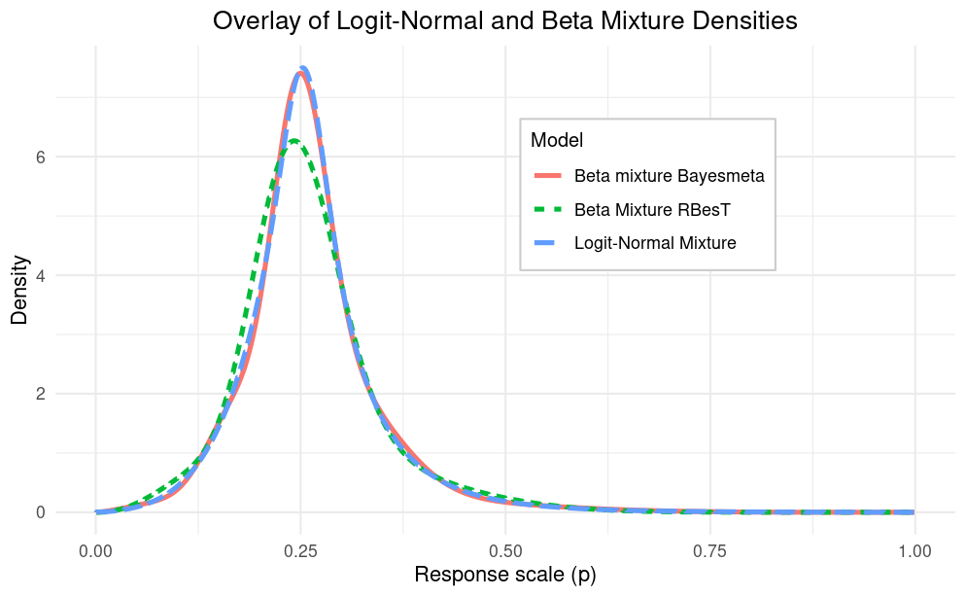



Posterior predictive density

Slide 19
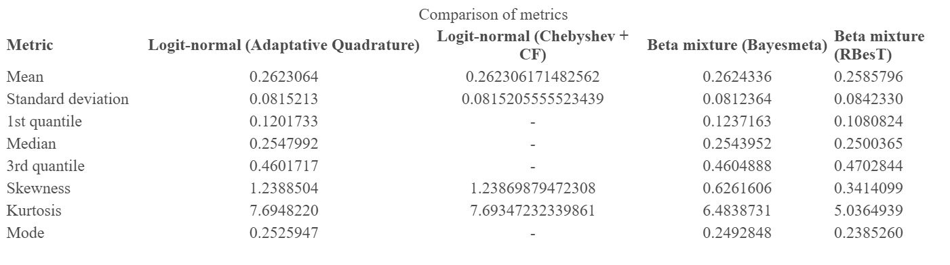
Metrics
Logit-normal: pushforwards Beta fit: Bayesmeta sample Rbest

Slide 20
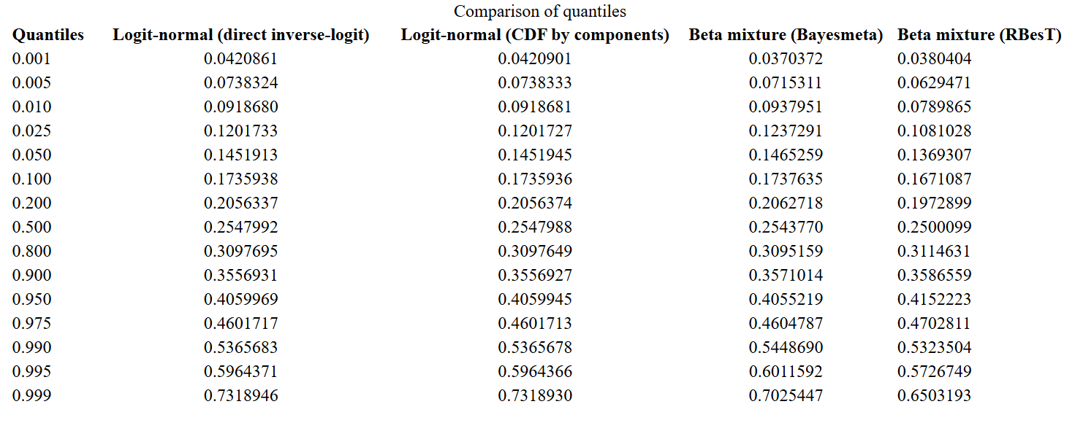
Quantiles
Logit-normal: pushforwards Beta fit: Bayesmeta sample Rbest

Slide 21
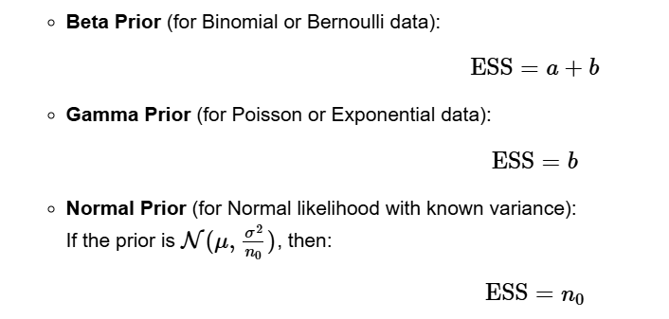
ESS: Moments
Conjugate distribution.

Slide 22
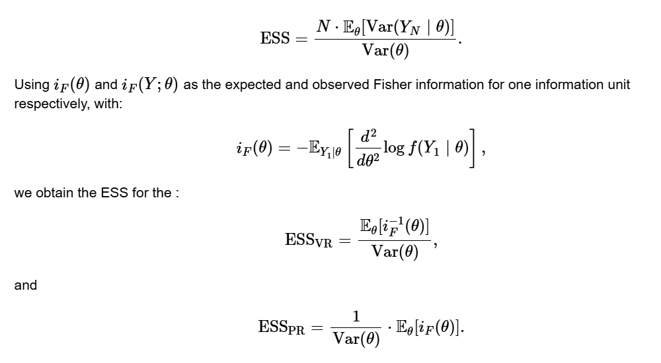
ESS: Moments
Variance & Precision ratio methods.

Slide 23
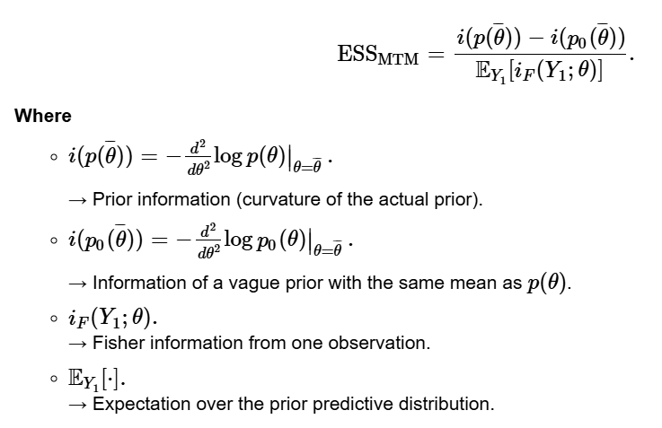
ESS: Morita

Slide 24
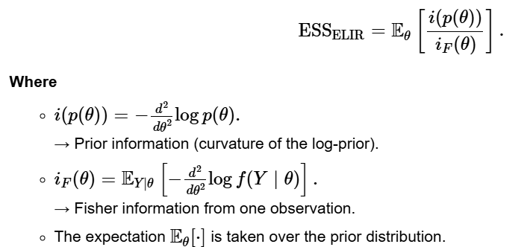
ESS: ELIR

Slide 25


ESS: Binomial likelihood
RBesT
Bayesmeta

Slide 26
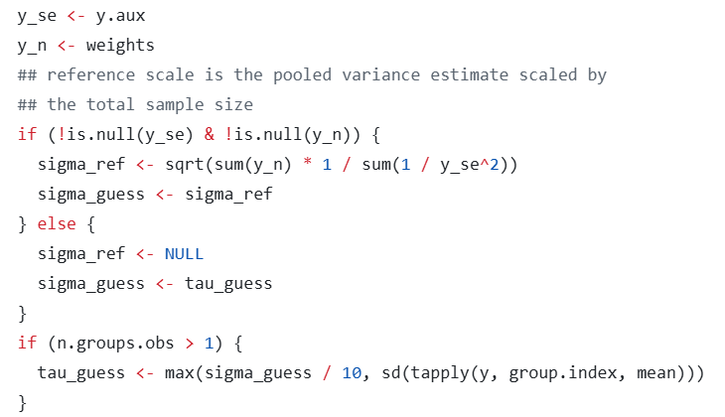
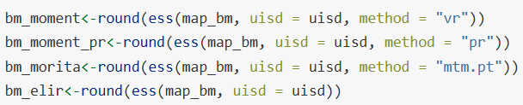
ESS: Normal likelihood
σ
(known)
RBesT
Bayesmeta

Slide 27
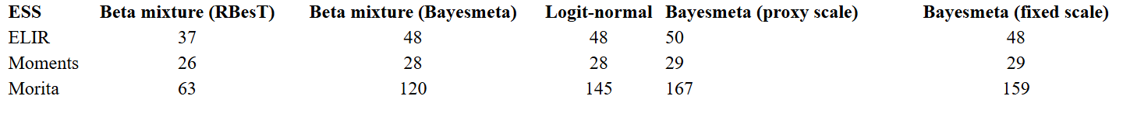
Rbest Bayesmeta sample beta fit Logit-normal: pushforwards Normal distribution
ESS

Slide 28

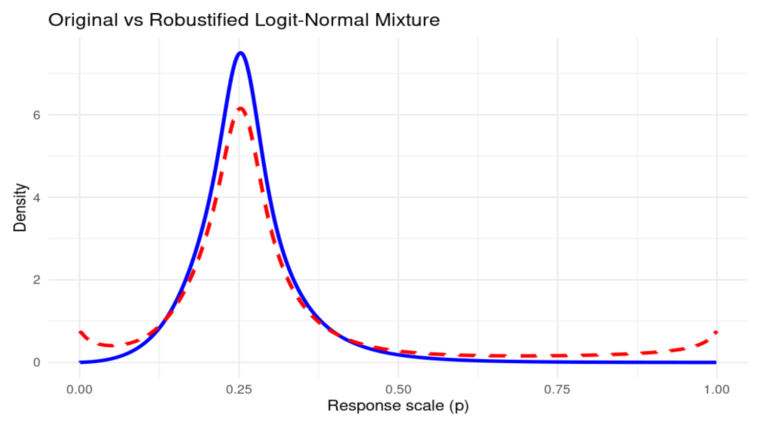
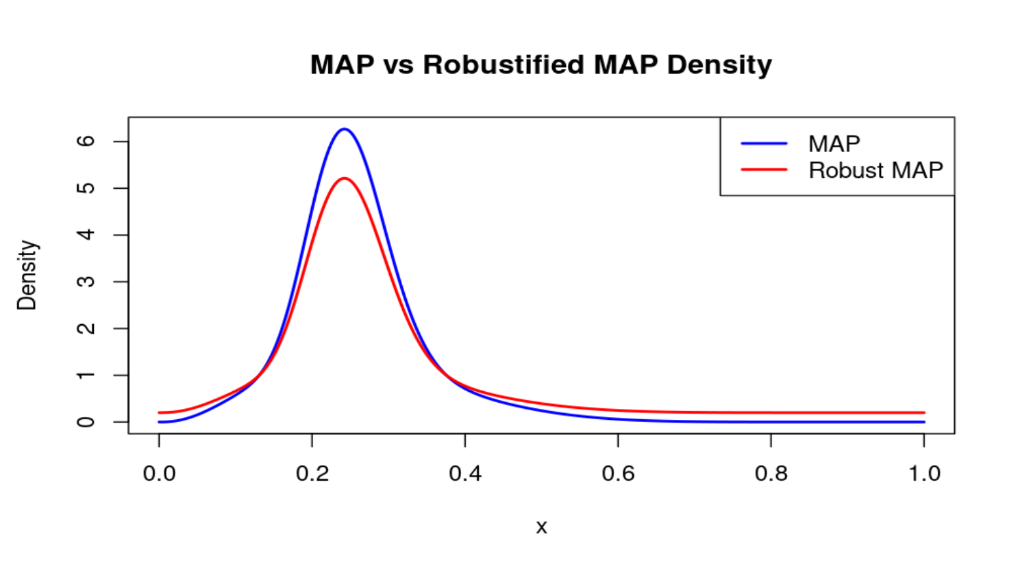
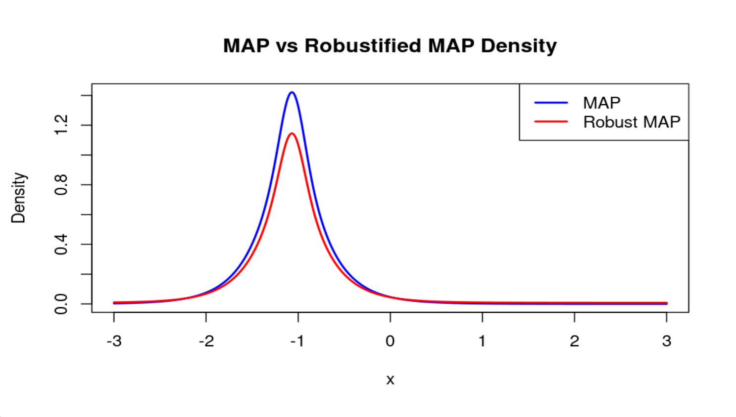
Robustification

Slide 29
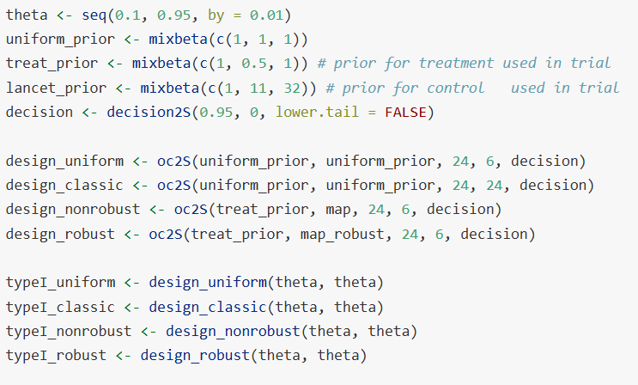
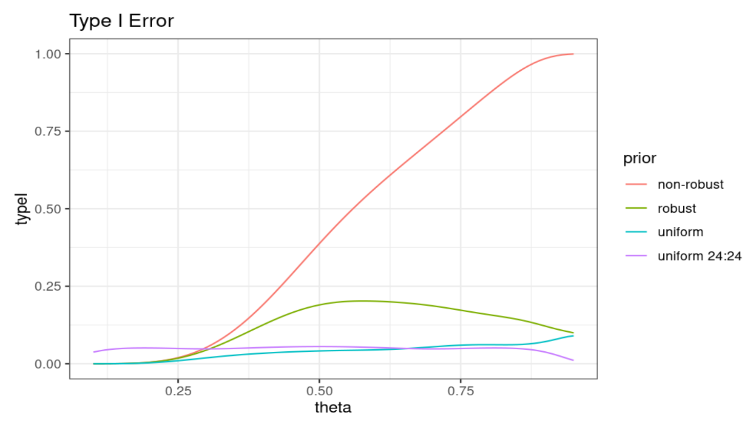
Design analysis

Slide 30
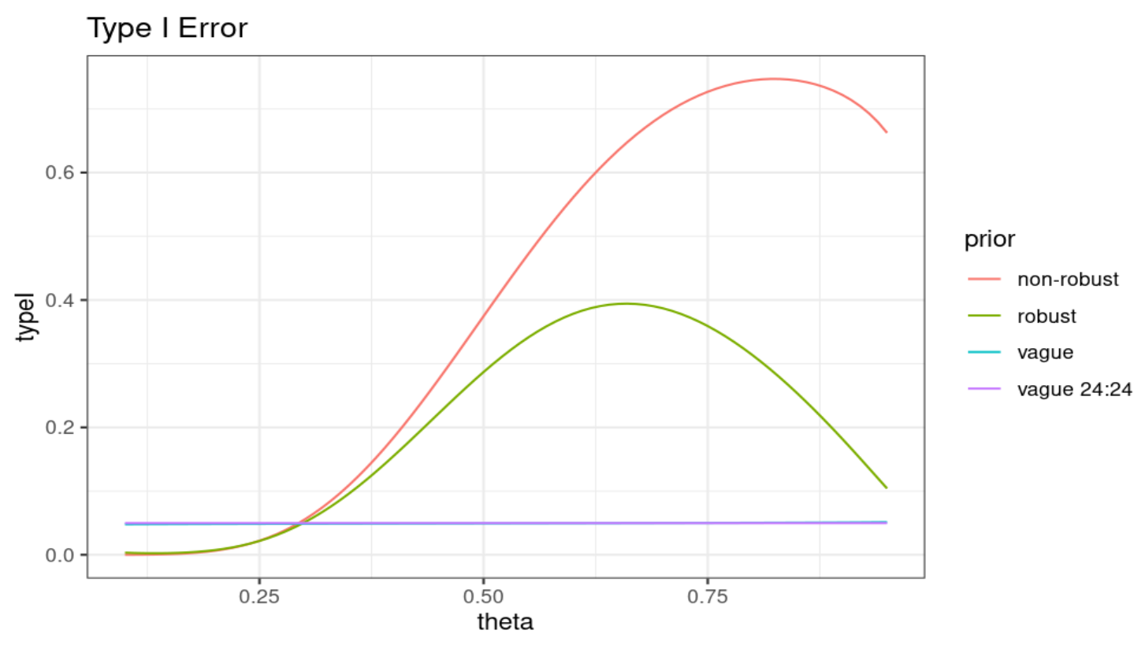
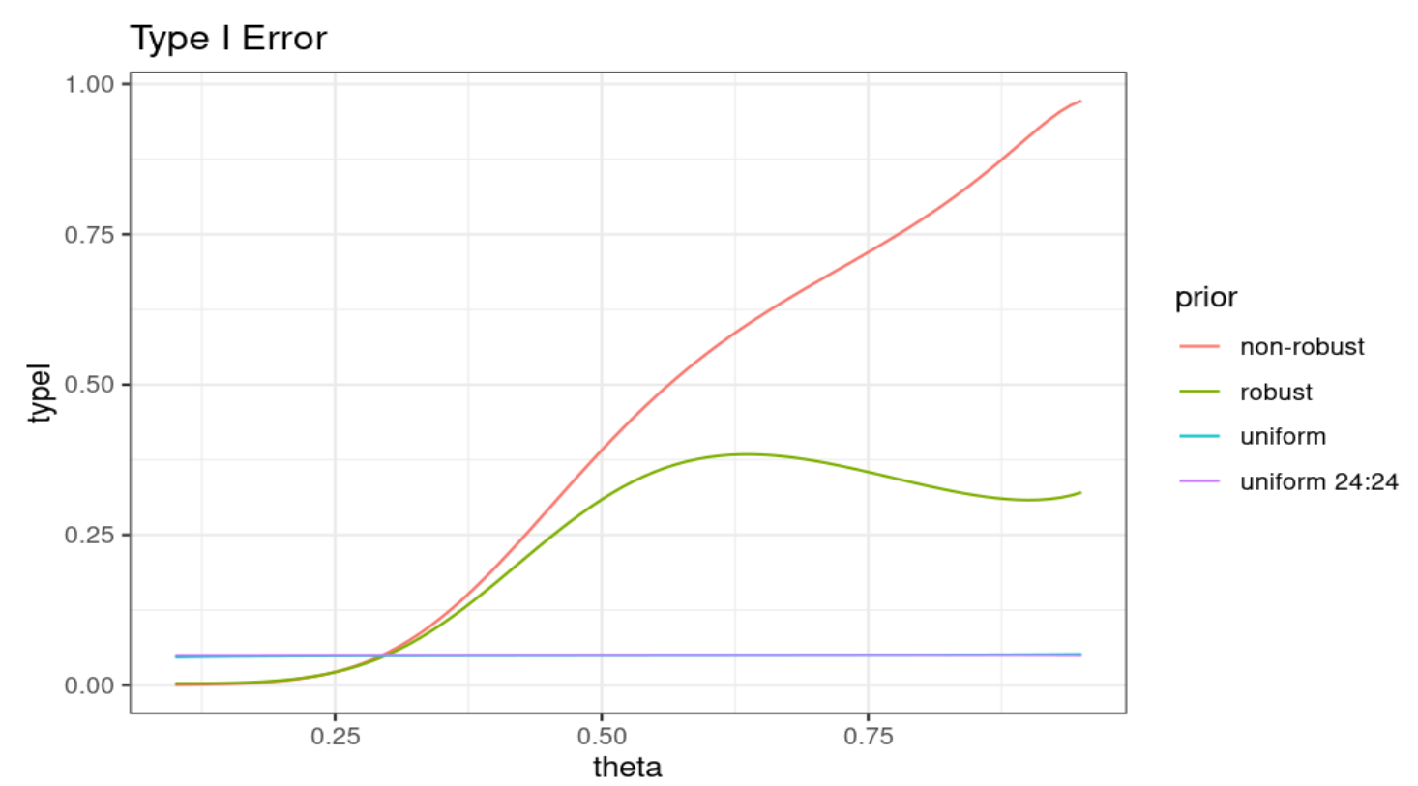
Design analysis

Slide 31
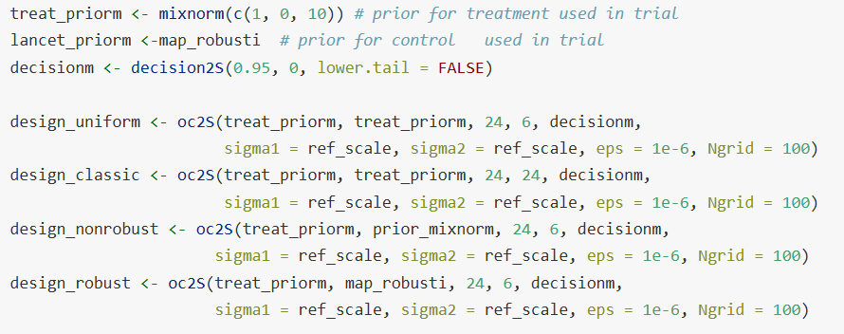
Design analysis

Slide 32
References
Weber, S., Li, Y., Iii, J. W. S., Kakizume, T., & Schmidli, H. (2021). Applying meta-analytic-predictive priors with the R Bayesian evidence synthesis tools. Journal of Statistical Software, 100(19). https://doi.org/10.18637/jss.v100.i19

